Slide 1

Software Data Prefetching
Advanced Computer Architecture
CPE631
Mohammad Al-Shurman & Amit Seth
Instructor: Dr. Aleksandar Milenkovic

Slide 2
Introduction
Processor-Memory Gap
  Memory speed is the bottleneck in the computer system
  At least 20% from stalls are D-cache stalls (Alpha)
  Cache miss is expensive
Reduce cache misses by ensuring data in L1
How?!

Slide 3
Data Prefetching
Appeared first with Multimedia applications using MMX technology or SSE processor extension
Cache memory designed for data with high temporal & spatial locality
Multimedia data has high spatial locality but low temporal locality

Slide 4
Data Prefetching (cont’d)
Idea
  Bring data closer to the processor before it is actually needed
Advantages
  No extra hardware is needed (Implemented in software)
  Used to mitigate the memory latency problem
Disadvantages
    Increase Code size

Slide 5
Example
//Before prefetching
for (i=0; i<N; i++) {
sum += A[i];
}
//After prefetching
for (i=0; i<N; i++) {
_mm_prefetchnta( &A[i+1], _MM_HINT_NTA);
sum += A[i];
}

Slide 6
Properties
prefetch instruction loads one cache line from main memory into cache memory
  During prefetching processor must continue execution
  Cache memory must support hits while prefetching occurs
  Decrease miss ratio
  It will be ignored if prefetched data exist in cache

Slide 7
Prefetching Instructions
The temporal instructions
  prefetcht0 fetch data into all cache levels, that is to L1 and L2 for Pentium III processors
  prefetcht1 fetch data into all cache levels except the 0th level, that is to L2 only on Pentium III processors
  prefetcht2 fetch data into all cache levels except the 0th and 1st levels, that is, to L2 only on Pentium III processors
Non-temporal instruction
  prefetchnta fetch data into location closest to the processor, minimizing cache pollution. On the Pentium® III processor, this is the L1 cache.

Slide 8
Prefetching Guidelines
prefetch scheduling distance
  What is the next data to prefetch?
minimize the number of prefetches
  optimize execution time!
mixing prefetch with computation instructions
  minimize code size and cache stalls

Slide 9
Important notice
Prefetching can be harmful if the loop is small
Combined with loop unrolling may enhance the application execution time
Can not cause exception if we fetch beyond the array index the call will be ignored

Slide 10
Support
Check if the processor support SSE extension (using CPUID inst)
    mov eax, 1 ; request for feature flags
    cpuid ; cpuid instruction
    test EDX, 002000000h ; bit 25 in feature flags equal to 1
    jnz Found
We used Intel compiler in our simulation
    Has built-in macro for prefetching
    Support loop unrolling

Slide 11
Loop Unrolling
Idea
  Test performance of code including data prefetch and loop unrolling
Advantages
  Unrolling reduces the branch overhead, since it eliminates branches
  Unrolling allows you to aggressively schedule the loop to hide latencies.
Disadvantages
  Excessive unrolling, or unrolling of very large loops can lead to increased code size.

Slide 12
Implementation of Loop Unrolling
//Prefetch without Unroll
for (i=0; i<N; i++) {
_mm_prefetchnta( &A[i+1], _MM_HINT_NTA);
sum += A[i];
}
//Prefetching with Unroll
#pragma unroll (1)
for (i=0; i<N; i++) {
_mm_prefetchnta( &A[i+1], _MM_HINT_NTA);
sum += A[i];
}
#pragma unroll (1)

Slide 13
Simulation
We simulate simple addition loop
for (i=0; i<size; i++) {
prefetch (depth)
sum += A[i];
}
We studied effects of two factors
  Data size
  Prefetch depth
Combination of loop unrolling and prefetching

Slide 14
Simulation (cont’d)
Intel VTune performance analyzer
Event based simulation
  CPI
  L1 miss rate
  Clock ticks

Slide 15
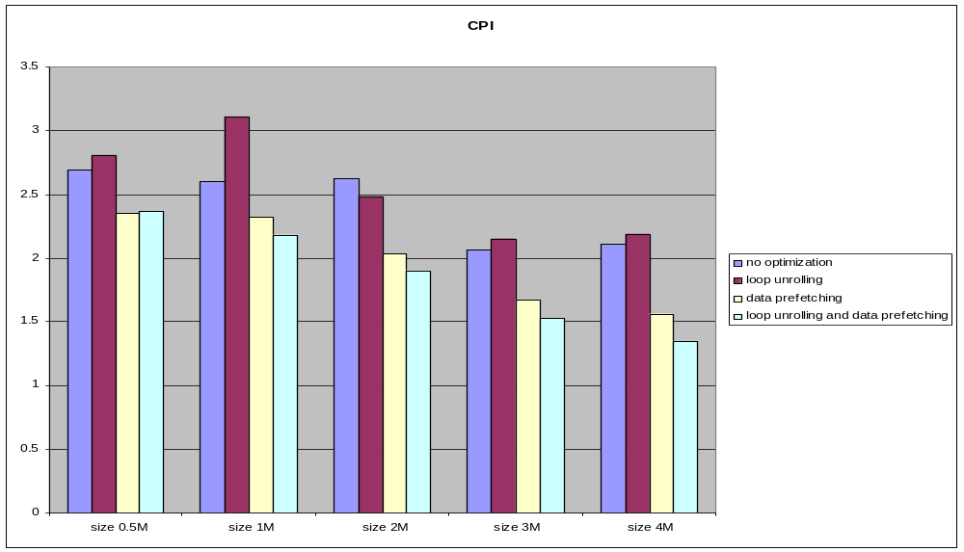
Size Vs CPI

Slide 16
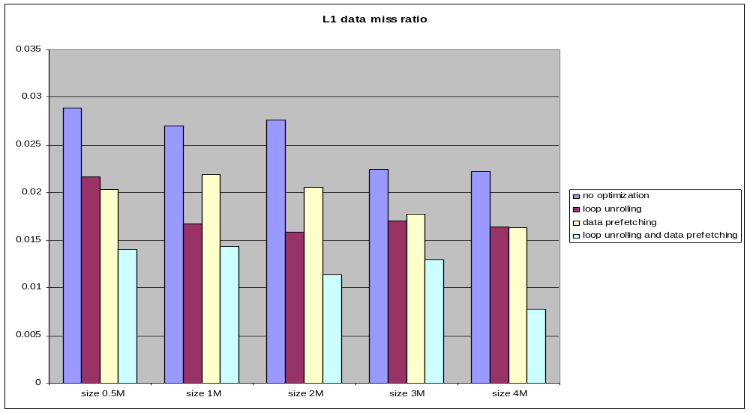
Size Vs L1 miss ratio

Slide 17
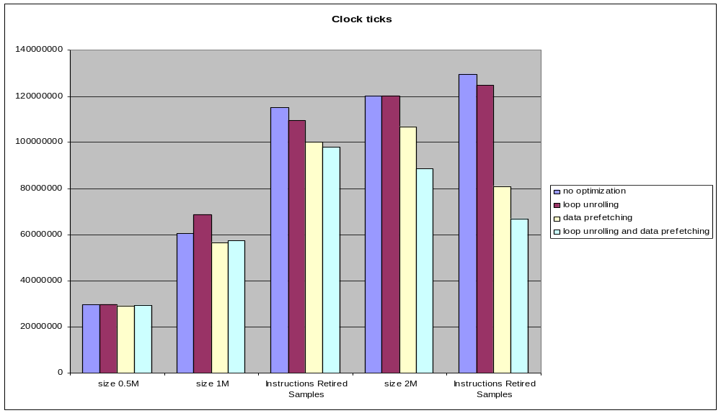
Size Vs clock ticks

Slide 18
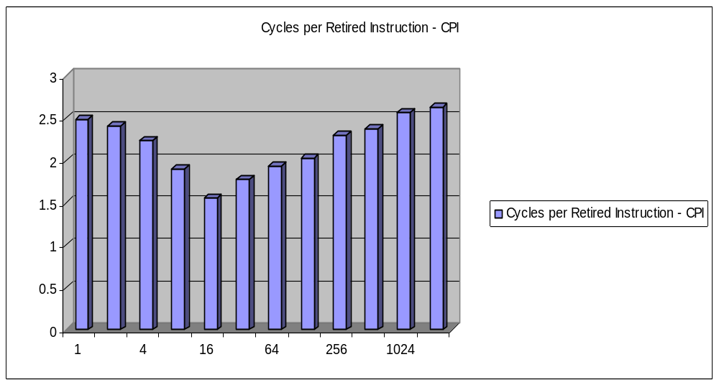
Depth Vs CPI for prefetching with unrolling

Slide 19
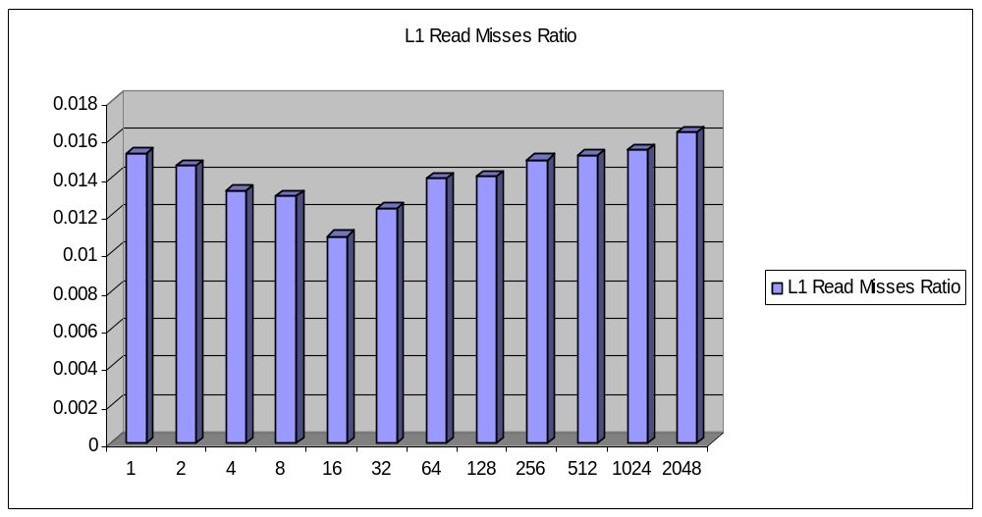
Depth Vs L1 miss ratio for prefetching with unrolling

Slide 20
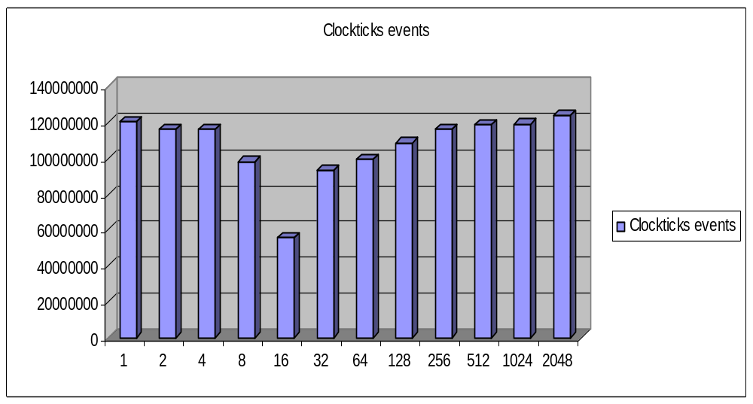
Depth Vs clockticks for prefetching with loop unrolling

Slide 21
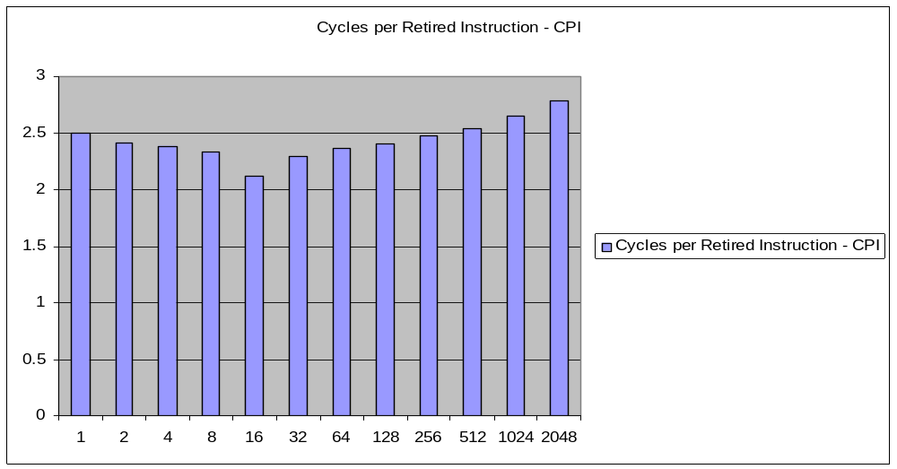
Depth Vs CPI for prefetching without loop unrolling

Slide 22
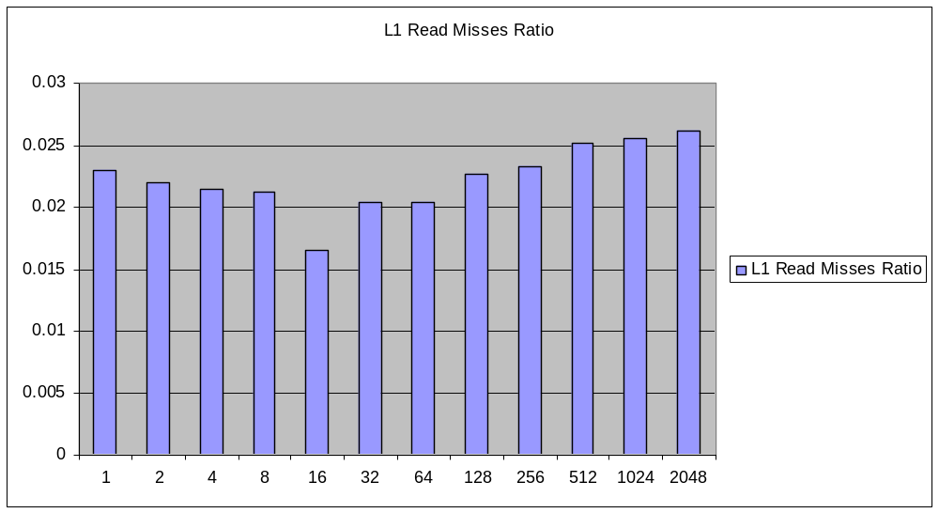
Depth Vs L1 miss ratio for prefetching without unrolling

Slide 23
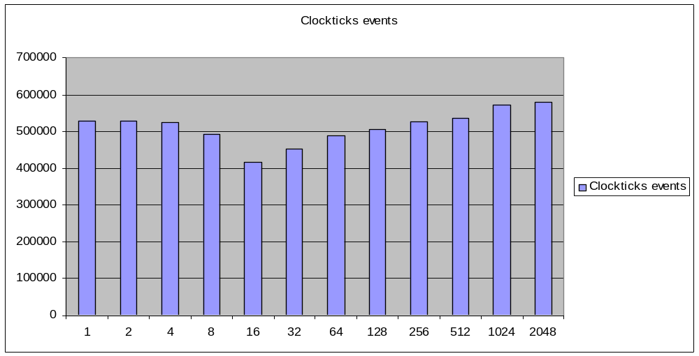
Depth Vs clockticks for prefetching without loop unrolling

Slide 24
Questions!!

